Slide 1
Concrete Admixtures

Slide 2
Chemical Admixtures
Material other than water, aggregate or cement added to concrete
Less than 5% by weight of cement
Branded, formulated products
Change certain properties
Can effect one another as well
Chlorides in admixture in reinforced concrete : <0,03% of cement mass

Slide 3
Use of Admixtures
Only with approval of engineer
  Information required
    Name and source
    Dosages & dosage apparatus
    Whether it can cause corrosion
    Anticipated air content (for AEA)
If more than one, check compatibility
Make trial mixes- do trials on site as well

Slide 4
Use of Admixtures
A good concrete design methodology is:
  Optimize the concrete design first without the use of admixtures and then only if necessary ‘tweak’ your mix with admixtures

Slide 5
Types of Admixtures
Plasticisers and superplasticisers
  Improve the effectiveness of the water in concrete
Retarders and accelerators
  Change the rate of the early chemical reactions and affect setting
Air entrainers
  Incorporate fine bubbles of air in a concrete mix
Water-resisting (waterproofing)

Slide 6
Water Reducers or Plasticisers
Plasticisers are described as dispersing admixtures
They work by uniformly dispersing the cement and other fine particles and hence increase the fluidity of the mix
The dispersing mechanism can be as a result of electrostatic repulsion or steric stabilisation.

Slide 7
Cement without admixture
Flocculated cement
Trapped water
Cement naturally flocculates
Mix water is trapped within flocs
Trapped water is not available for workability
Workability low to minimise water / cement ratio

Slide 8
Cement with plasticising admixture
Cement is deflocculated
Entrapped water is released
Cement particles move freely
Workability increases
Cement hydration improved

Slide 9
Water Reducers or Plasticisers
Types:-
  Lignosulphantes (often taken from the wood processing industry)..most common type
  Polycarboxylate ethers. Supplied as a dilute solution. They have less secondary effects…more modern type

Slide 10
Plasticisers
Effectiveness
  Reduces water by 10 - 15 ℓ/m³
  Reduced effectiveness at high C₃A contents
  A:C ratio
    Lignosulphonates - used for low cement content
    Polycarboxylate ethers- high cement content
  More effective with higher slumps mixes
  20% strength improvement at 24 to 36 hours
  12% strength improvement at 28 days

Slide 11
Applications
Workability = A
Strength > B
+Adm
-W
+Adm
Workability = A
Strength = B
Workability = A
Strength = B
-W -C
Workability > A
Strength = B
+Adm

Slide 12
Plasticisers
Precautions
  Most plasticisers have a slight retarding action and so overdosing can cause severe retardation
  Lignosulphonates
    Increase air entrainment
    Decrease bleeding
  Polycarboxylate ethers may increase bleeding

Slide 13
Superplasticisers
Also known as ‘High Range Water Reducers’
Typically give a 12% to 30% reduction in water
Used in SCC (Self-Compacting Concrete)and high strength concrete
Very sensitive to surrounding conditions with a high variance in performance

Slide 14
Cement dispersion by Superplasticiser (SP)
Coagulation
Adsorption of SP
Dispersion
Cement
SP
- Adsorption velocity
- Adsorption amount

Slide 15
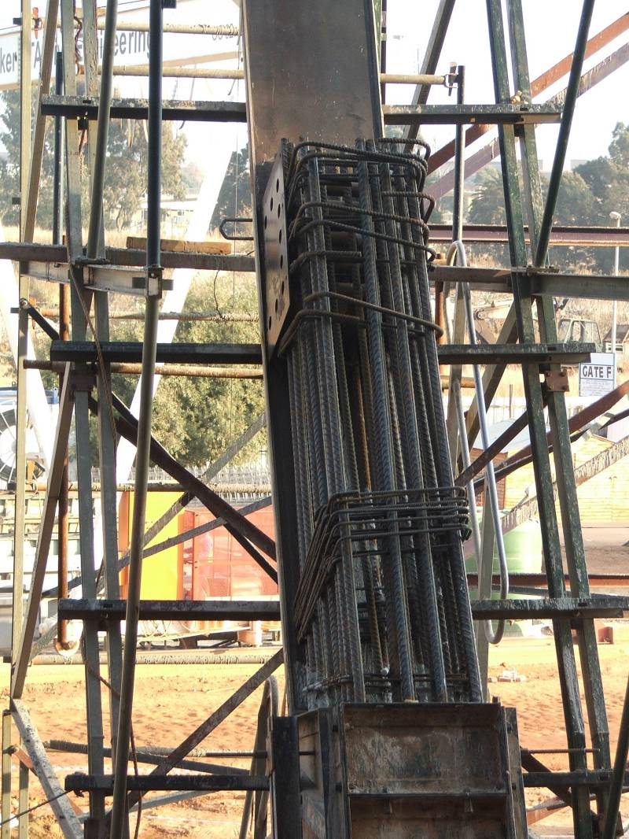
Superplasticiser
Applications
  For congested reinforcing
  Self leveling floors
  Shaft linings
  High strength concrete

Slide 16
Superplasticiser
Effectiveness
  Dosage
    0,5 - 2 % of cement mass
    10 - 30 % water reduction
  Cement type
    Less effective for low C₃A
  Aggregates
    Increase fines for cohesion
    Improve stone shape to resist segregation
  Measure consistence with flow test
  Examples - There exist four main categories of superplasticizers: sulfonated melamine-formaldehyde condensates; sulfonated naphthalene-formaldehyde condensates; modified lignosulfonates; and others such as sulfonic-acid esters and carbohydrate esters

Slide 17
Superplasticiser
Life span
  Limited life - 35 min - 45 min
  Lose effect rapidly at high temperatures
Timing
  Add immediately before discharge
  Make sure it is dispersed well

Slide 18
Superplasticiser
Precautions
  Cohesion loss
  Lower yield due to water reduction
  Limited life
  Vibration could cause segregation
  Additional pressure on formwork

Slide 19
Accelerators
Two types of Accelerators:-
Set Accelerators
  Reduce time the concrete stays in its plastic state
Hardening Accelerators
  Speed up the strength gain after initial set

Slide 20
Accelerators
CALCIUM CHLORIDE
Most effective accelerator that is used for both set and hardening acceleration
Will increase chloride content in concrete and it’s use is banned in reinforced concrete
Use chloride free accelerator for reinforced concrete such as Calcium Formate

Slide 21
Accelerators
Mechanism of Acceleration
Set accelerators may work by accelerating the formation of ettringite
Inorganic hardening accelerators increase the rate of reaction of C₃S and C₂S leading to earlier strength gain
Accelerators containing high range water reducers work by reducing the distance between cement particles …more intermeshing of gel

Slide 22
Accelerators
Factors affecting performance
Cement type
  Slow or fast hydration, type and amount of extenders
Temperature
  More effective at lower temperatures
  Take care when temperatures are high

Slide 23
Accelerators: Applications
Early demoulding (precast)
Reduce freezing risk
  Do not depress freezing point
Shaft linings
  5 MPa at 8 hours
Early set for finishing floors

Slide 24
Accelerators
Precautions
  Calcium chloride - Ca(Cl)₂
    Cause corrosion of steel reinforcement
    Reduce sulphate resistance
    Increase drying shrinkage and creep
  Increases heat of hydration
  Can cause rapid stiffening
  Calcium formate is an alternative

Slide 25
Retarders
Slow down initial reaction between cement and water by slowing down hydration products
Extend setting time by between 1.5 to 6 hours
Most retarders sold as a combination of retarder and plasticizer
Extensively used in the ready mix industry
Typically have a high dosage rate
Be careful of overdosing
Temperature can have a big effect on retarding action

Slide 26
Retarders
Mechanisms of retardation
One or both of the following:
  Adsorbs onto cement surface slowing formation of silicate hydrates
  Prevent the binding of calcium ions in solution so preventing the formation of Calcium Hydroxide
  (Calcium Hydroxide = Portlandite)

Slide 27
Retarders
Applications
  Mass pours
    Prevent cold joint
    Less heat of hydration
  Long haul distances
  Hot weather
  Unforeseen delays

Slide 28
Retarders
Precautions
  Increased bleeding time, needs careful mix design
  Increased plastic shrinkage
  Increased loading on formwork
  Reduced durability (cracking, bleed water channels)
  Reduced/increased rebar bond due to vibration

Slide 29
Retarders
Precautions
  Overdosing causes very lengthy retardation
  Strength development after retardation is normal
  Bleeds for a longer period
    More defined bleeding channels
    Increase risk of plastic shrinkage and settlement
    Increased risk of weak floor surface

Slide 30
Air Entraining Agents (AEA)
Surfactants (usually organic) that change surface tension of water
Generate air bubbles throughout mix.
Bubbles are smaller than 1mm in diameter with most of them smaller than 0.3mm
Bubbles are evenly dispersed and should be between 0.1mm and 0.2mm apart

Slide 31
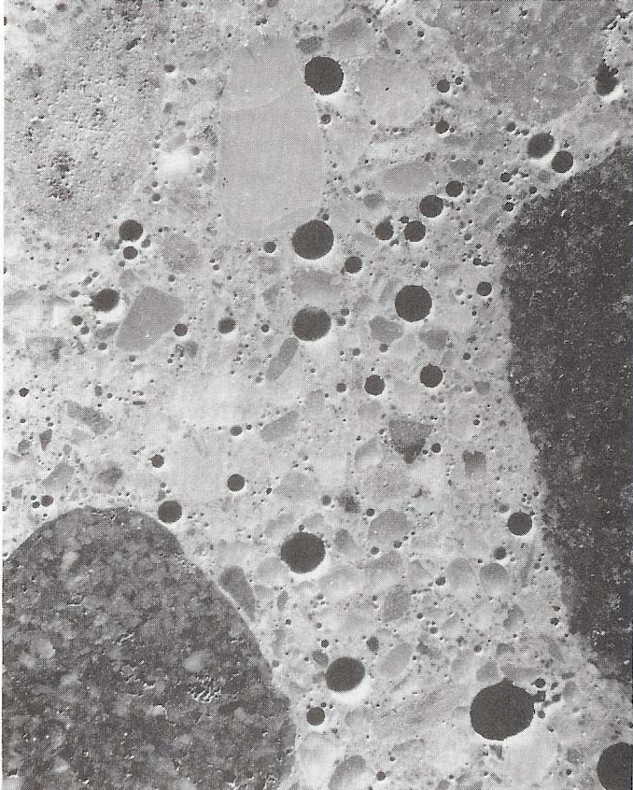
Entrained Air Under a Microscope

Slide 32
Air Entraining Agents (AEA)
Volume of air required relates to maximum aggregate size Dmax
Reduction in Dmax, require more air to maintain bubble spacing as concrete with smaller aggregate have higher paste volume
Should be specified by minimum value
Permitted air content between 0.5% below and 5% greater than minimum specified

Slide 33
Air Content of Air-Entrained Concrete in Accordance with BS EN 206-1
Nominal maximum aggregate size, Dmax | Minimum specified volume of entrained air | Minimum measured volume of entrained air | Maximum measured volume of entrained air
32 or 40mm | 3 | 2.5% | 6.5%
20mm | 3.5 | 3.0% | 8.5%
10mm | 5.5 | 5.0% | 10.5%

Slide 34
AEA
Applications
  Frost resistance
    Interrupts capillaries by increasing diameter so that water (with dissolved deicing salts?) is not drawn into concrete
    Allows space for expansion when water freezes
Air reduces strength : design and dose correctly

Slide 35
AEA
Acts as very fine sand
  Improves workability
  Improves cohesion
  Improves pumping properties
  Reduces bleeding
  Improves extrusion properties

Slide 36
AEA
Effectiveness
  Dosage
    5% air will increase slump by 20 - 60 mm
  Cement type
    Finer cement will decrease proportion of air
  Aggregates
    Some mineral types resist
    High proportion of fine sand (<150µm) will decrease the proportion of air

Slide 37
AEA
Precautions
  Temperature
    High temperatures result in a decrease in the proportion of air
  Mixing time
    Too short will result in uneven dispersion
    Too long will reduce air content
  Mix speed
    Faster mixing speeds result in increased air content

Slide 38
Water-Resisting Admixtures
Type 1:
Hydrophobic water resisting admixtures react with cement to form insoluble coating to walls of capillary voids. Works well where no water pressure is present, such as rain or splash zone. Effective in preventing chloride drawn into reinforced concrete in splash zone of marine structures or from de-icing salts.

Slide 39
Water-Resisting Admixtures
Type 2:
Capillary blocker types are based on polymer emulsions and/or reactive inorganic minerals. Designed to block capillaries by forming physical barrier preventing water ingress, even under significant water pressure.

Slide 40
Admixture Dosage
Range from 0,2 to 2,0 litres per 100 kg of cementitious materials
Correct dosage is crucial for satisfactory mix performance
Proper use of well maintained, and calibrated dispensing equipment is essential
Small changes in actual dosing can have a significant effect on concrete quality and properties.

Slide 41
Admixture Dispensing
Liquids usually added to mixing water
If added to concrete, check the discharge rate and timing of sequence
If not compatible, two admixtures should be dosed at different times or locations.

Slide 42
Dispensing Equipment
Dosages are small and accuracy very important
Accuracy of equipment
  Dose within 5%
  Safe device against overdosing
  A sight glass for visual inspection
  Provision for calibration
  Have a means of flushing the system

Slide 43
Trial Mix Design
Optimum dosage depend on cement type, concrete proportions, grading of fine aggregate and temperature
Admixtures may perform differently under different circumstances and in situ testing is necessary
Compatibility
  With other admixtures
  With materials in use
Do trials frequently on site!

Slide 44
End

Slide 45

Feedback

